Slide 1

Rainfall Prediction using Machine learning Algorithms
MADANAPALLE INSTITUTE OF TECHNOLOGY AND SCIENCE
Department of Civil Engineering
Presented by:
G. Vijaya Shobaraj
M. Lakshmi Bhavani
Guide:
Dr. Dipankar Roy

Slide 2
Contents
Introduction
Objective
Literature review
Methodology
Result

Slide 3
Introduction
The main focus of the study is to forecast Rainfall which is very important because heavy and irregular rainfall can have many impacts like destruction of crops and farms, damage of property so a better forecasting model is essential for an early warning that can minimize risks to life and property and also managing the agricultural farms in better way. This prediction mainly helps farmers and also water resources can be utilized efficiently. Rainfall prediction is a challenging task and the results should be accurate. These traditional methods cannot work in an efficient way so by using machine learning techniques we can produce accurate results. We can just do it by having the historical data analysis of rainfall and can predict the rainfall for future seasons

Slide 4
Objective
Predicting Rainfall by using different machine learning algorithms.
To improve accuracy compared to the conventional methods.
Adopting advanced technology to decrease the computing cost.

Slide 5
SL NO​ | JOURNAL ​ | AUTHOR​ | Algorithms used:-​
1​ | Machine learning techniques to predict daily rainfall amount​ | Liyew C.M, Melese H.A. ​ | Multivariate linear regression​ Random forest​ ​
2​ | Rainfall Prediction using Multiple Linear Regressions Model​ | Hiyam A bobaker, Yousif Ahmed , Sondos W. A. Mohamed ​ | ​
3​ | Machine Learning based Rainfall Prediction​ | R. Kingsy Grace, B. Suganya ​ | ​
4​ | A Novel Study of Rainfall in the Indian States and Predictive Analysis using Machine Learning Algorithms​ | Nikhil Tiwari, Anmol Singh​ | ​
5​ | Comparative Study of Machine Learning Algorithms for Rainfall Prediction​ ​ ​ | Mylapalle Yeshwanth, Palla Ratna Sai Kumar, Dr. G. Mathivanan ​ | ​

Slide 6
SL NO​ | JOURNAL​ | AUTHOR​ ​ | ​
6​ | Rainfall Prediction Using Machine Learning Algorithms for the Various Ecological Zones of Ghana​ | N. K. A. Appiah-Badu et al ​ | ​
7​ | Comparable investigation for rainfall forecasting using different data mining approaches in Sulaymaniyah city in Iraq​ ​ ​ | Scherko Murad, Yusra Mohammed​ | ​
8​ | Hybrid prediction models for rainfall forecasting ​ | Gurpreet Singh, Deepak kumar ​ | ​
9​ | Comparative Analysis of Statistical Models in Rainfall Prediction​ ​ ​ | Jinghao Niu, Wei Zhang​ | ​
10​ | Rainfall Prediction Using Machine Learning & Deep Learning Techniques​ | B. Revathi, C.Usharani ​ | ​

Slide 7
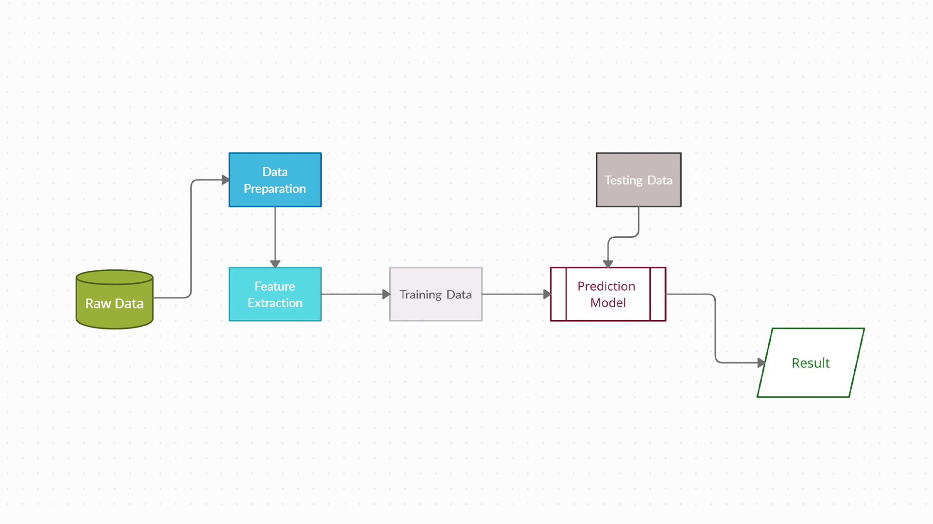
Methodology

Slide 8
Raw Data
We have selected Madanapalle region as the study area (31 mandals)
Data collected from Sub Collector Office, Madanapalle
The dataset consists of monthly Rainfall from the year 1988 – 2022
Meteorological variables are collected from India Meteorological Department.
Data Preparation
Transforming the raw data by formatting
Feature Extraction
process of transforming raw data into numerical features
Variables considered: Windspeed, Cloud cover, Humidity, Min Temperature, Max Temperature, Mean Temperature

Slide 9
Training data
A training set will be implemented to build up a model to predict the outcome
70% of the data is training data
Prediction Model
These are the machine learning algorithms are used to build model
Multiple Linear Regression
Decision Tree
K nearest neighbors
Logistic Regression
Random Forest
Naïve Bayes
Validation
30% of the data will be used for Testing to evaluate the performance of the model

Slide 10
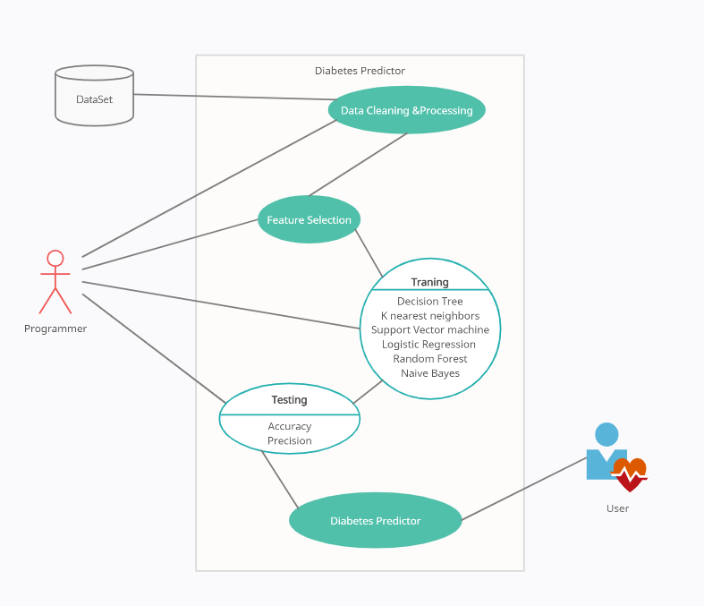
UML Diagram
Rainfall predictor
USER
Rainfall predictor

Slide 11
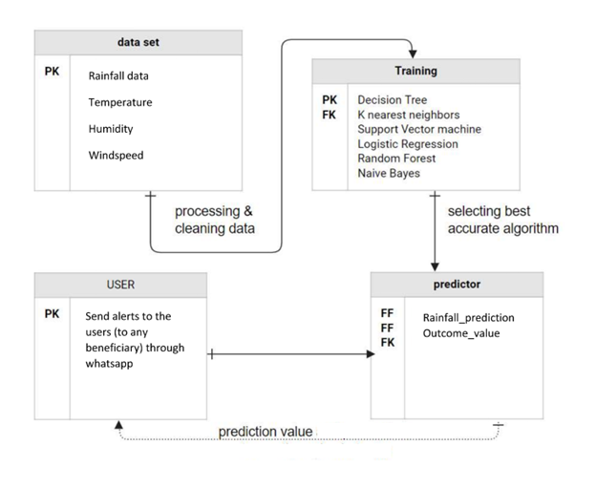
Sequence Diagram

Slide 12
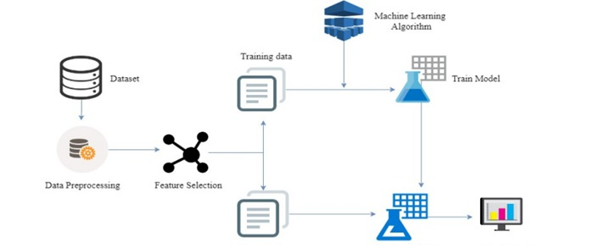
UML Diagram

Slide 13
Packages and Libraries
NUMPY
PANDAS
SCIKIT-LEARN

Slide 14

Numpy
Numpy
NumPy is the library for the python language which provide arrays and matrices for the storing the large data. It provides and support high-level and more mathematical functions which works on these NumPy arrays and matrices.

Slide 15

Pandas
Pandas is the library for the python language which is used for data manipulation and analysis of data. It provides some data structures and operations for the manipulation and analysis.

Slide 16

Scikit-Learn
Sklearn is the library for python language which is used for implementing the different machine learning algorithms on the data set. It provides the different algorithms methods to implement easily and accurately

Slide 17
Machine learning algorithms
Linear Regression
Naïve Bayes
Random Forest
Knearest Neighbors
Decision Tree
Support Vector Machine

Slide 18
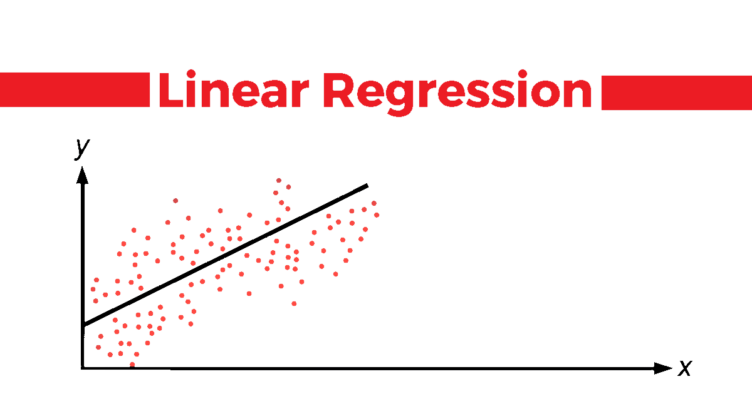
Linear regression
Linear regression is a supervised learning machine learning algorithm. It carries out a regression task. Based on independent variables, regression models a goal prediction value.

Slide 19
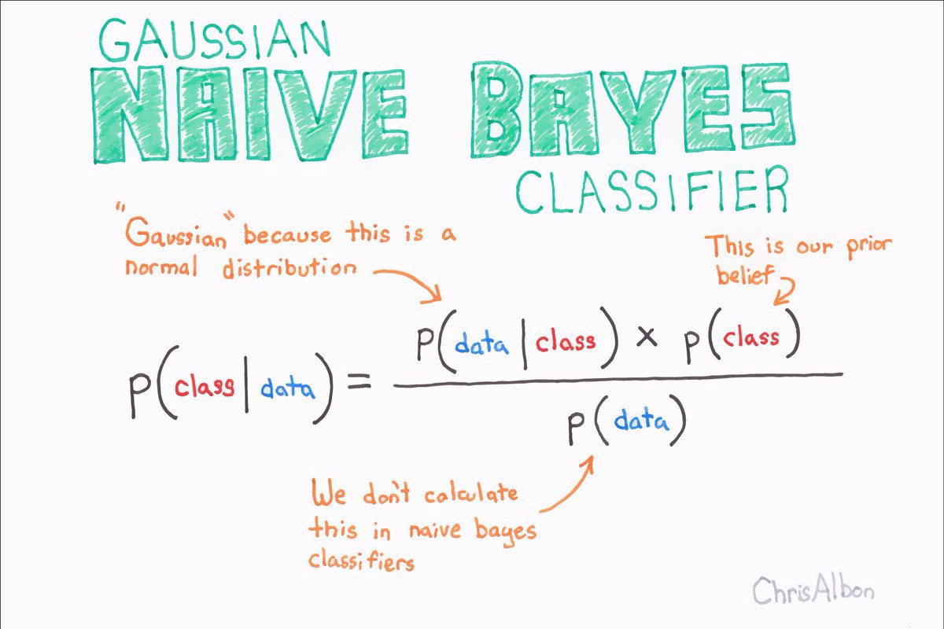
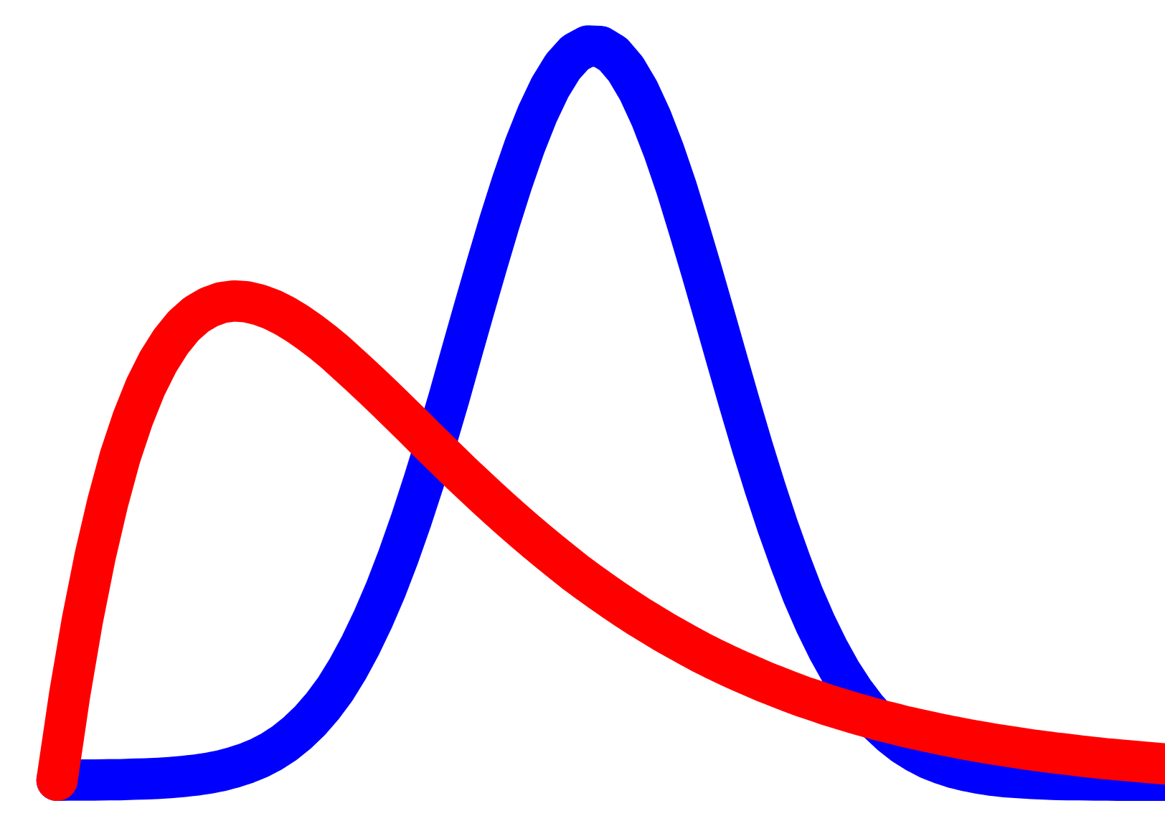
Naïve Bayes
The Bayes' Theorem is used to create a collection of classification algorithms known as Naive Bayes classifiers. It is a family of algorithms that share a similar idea, namely that each pair of features being classified is independent of the others.

Slide 20

Random Forest
Random forest is a machine learning technique that use a collection of decision trees to produce output with greater flexibility, accuracy, and accessibility. This technique outperforms decision trees because decision trees have worse accuracy than the random forest algorithm.

Slide 21
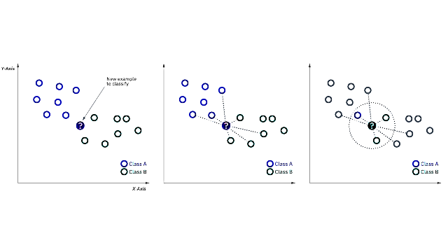
Knearest Neighbors
K-Nearest Neighbours is one of Machine Learning's most basic but crucial categorization algorithms. Pattern recognition, data mining, and intrusion detection are just a few of the applications it finds in the supervised learning domain.

Slide 22
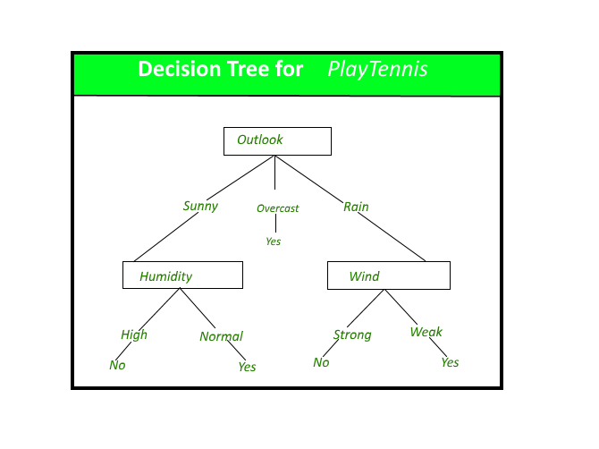
Decision Tree
The most powerful and widely used tool for categorization and prediction is the decision tree. A decision tree is a flowchart-like tree structure in which each internal node represents an attribute test, each branch reflects the test's outcome, and each leaf node (terminal node) stores a class label.

Slide 23

Support Vector Machine
A supervised learning system called a support vector machine is used to solve classification and regression problems. Many people prefer the support vector machine because it produces significant correctness while using less computing power. It's primarily used to solve categorization challenges.

Slide 24
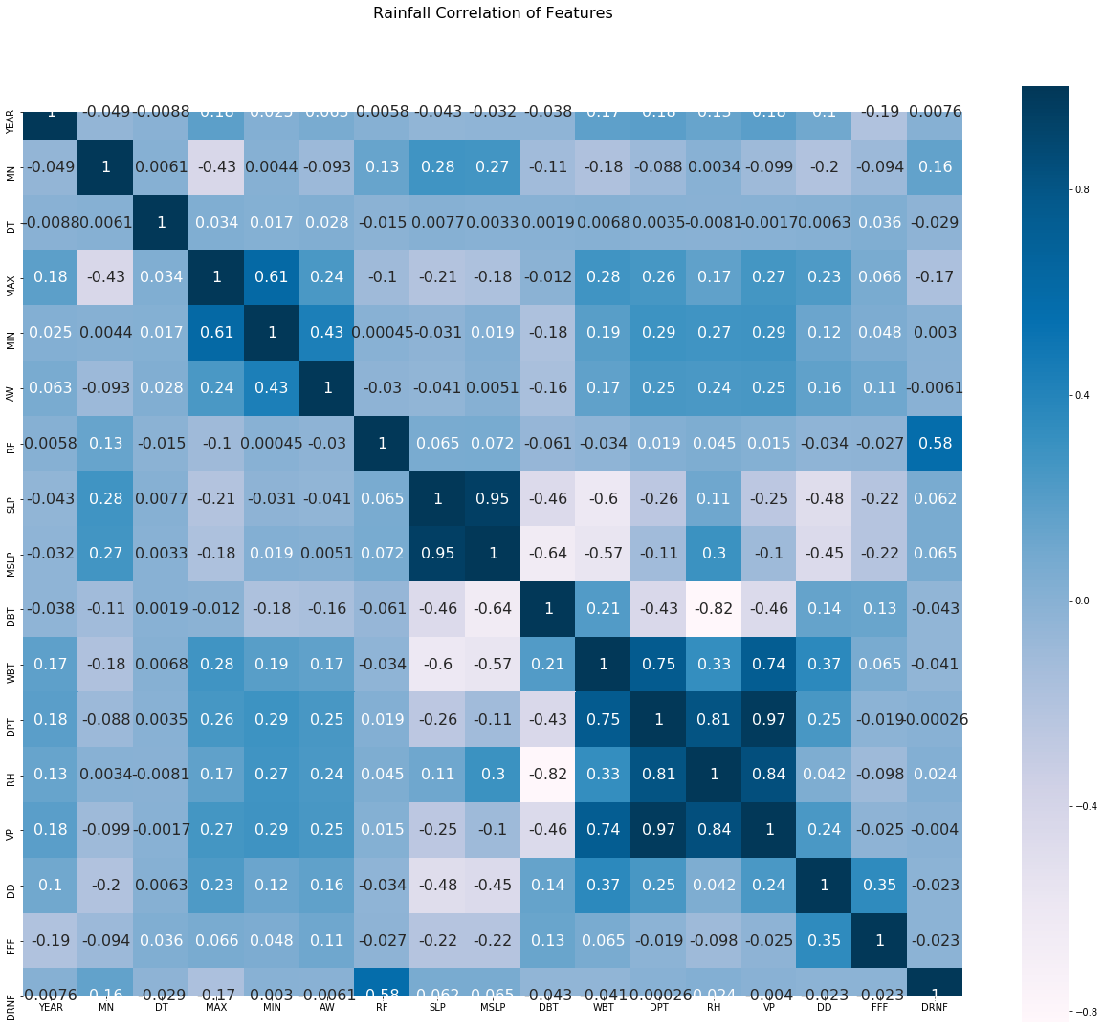
Heatmap
A heatmap is a visual representation of data in a color-coded matrix. Color intensity fluctuates depending on the value of the property in the visualisation. A heatmap is a data visualisation that uses a color-coded matrix to display information. Color intensity fluctuates depending on the value of the property in the visualisation

Slide 25
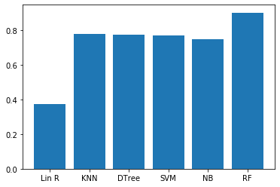
Accuracy of Machine learning algorithms
According to the graph below, Random Forest is the most accurate machine learning method when all scores are compared
Linear Regression : 0.3733002424817602,
KNearest Neighbors : 0.7788018433179723,
Decision Tree : 0.7753456221198156,
Support vector Machine : 0.7723502304147466
Naïve Bayes : 0.7511520737327189,
Random Forest : 0.903808694101612
Performance of Algorithms

Slide 26
Result
Implementation of Random Forest
Finally, based on its accuracy, Random Forest method was chosen as the prediction model.
def random_forest(l):
train_features, test_features, train_labels, test_labels = train_test_split(features, Y)
train_features.iloc[-1]=l
model=RandomForestRegressor()
model.fit(train_features, train_labels)
predicted_value=model.predict(train_features)
return predicted_value[-1]

Slide 27
Thankyou

